Slide 1


DEPARTMENT OF COMPUTER SCIENCE & ENGINEERING
TELECOM SUBSCRIBER CHURN PREDICTION USING DEEP LEARNING: EXAMINING THE INFLUENCE OF CUSTOMER CHARACTERISTICS AND SERVICE OFFERINGS
Mrs. Anandhi S K
Assistant Professor
Ilakia S R(200701309) Shruthi K (200701237)

Slide 2
ABSTRACT
Telecom companies are grappling with customer churn, where subscribers switch to competitors, impacting revenue. They're countering this with predictive analytics and Deep Learning, analyzing historical data to forecast churn. Popular methods include Gradient Boosting and Random Forest, but advanced techniques like LightGBM are gaining traction. Integrating Convolutional Neural Networks (CNNs), Long Short-Term Memory (LSTM) networks, and hybrid models improves prediction accuracy. Evaluation involves metrics like F1-score and accuracy. By analyzing customer data, including tenure and charges, telecoms can predict churn and retain customers, as retaining is cheaper than acquiring new ones. By leveraging predictive analytics tools, telecom firms aim to identify at-risk customers and tailor retention strategies accordingly. The ultimate goal is to empower telecom providers with actionable insights to address churn and strengthen their competitive edge in a volatile market

Slide 3
PROBLEM STATEMENT
Telecommunication companies are grappling with customer churn, where subscribers switch to competitors, impacting revenue. To address this challenge, the project aims to develop a predictive model leveraging advanced Deep Learning techniques and predictive analytics to accurately forecast churn among telecom subscribers. By analyzing historical data, including customer attributes such as tenure and charges, the goal is to empower telecom providers with actionable insights to identify at-risk customers and implement targeted retention strategies. The ultimate objective is to reduce churn rates and strengthen the competitive edge of telecom companies in a dynamic market environment.

Slide 4
OBJECTIVES
The main objective of a customer churn prediction project is to identify customers who are likely to churn (stop using the product or service) in the near future.
Enhance churn prediction accuracy through effective segmentation.
Ensure data cleanliness and compatibility for reliable model performance.
Employ diverse machine learning and deep learning models for comprehensive analysis.
Rigorously evaluate model performance to select the most reliable one.
Regularly monitor deployed models for consistent churn risk mitigation.

Slide 5
EXISTING SYSTEM
An in-depth analysis of historical customer data involves examining call logs, usage patterns, and billing information. Simple statistical models like logistic regression or decision trees are used to estimate churn likelihood. However, manual customer categorization and static thresholds may overlook subtle churn indicators and fail to adapt to evolving behavior. Lack of real-time capabilities limits agility in responding to churn signals, hindering tailored retention strategies.

Slide 6
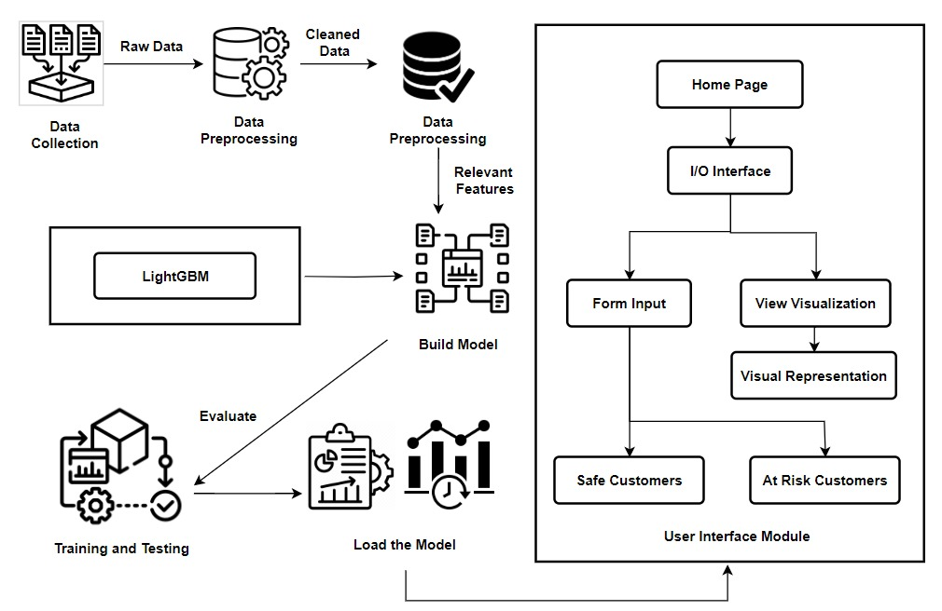
SYSTEM ARCHITECTURE

Slide 7
LIST OF MODULES
Customer Churn Prediction is divided into seven modules:
Data Collection and Preparation
Feature Engineering
LightGBM Model
Model Evaluation and Deployment

Slide 8
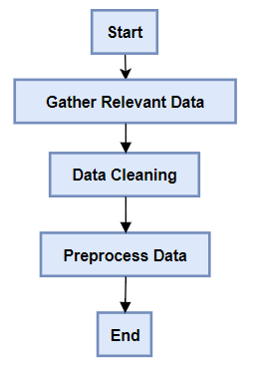
FUNCTIONAL DESCRIPTION OF MODULES
Data Collection and Preparation
Customer churn prediction involves collecting data from diverse sources, including databases and surveys. The gathered information undergoes meticulous cleaning to address missing values and ensure accuracy. This refined dataset serves as a strong foundation for developing accurate churn prediction models. Businesses can then formulate proactive retention strategies, enhancing overall customer retention efforts and ensuring success.

Slide 9
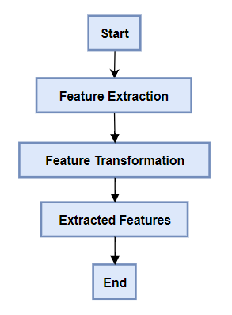
FUNCTIONAL DESCRIPTION OF MODULES
Feature Engineering
The feature engineering module in customer churn prediction is vital for model refinement. It begins with feature selection, identifying key variables for predicting churn. The subsequent step involves transforming and preprocessing selected features. This module contributes to constructing a robust churn prediction model, enhancing understanding and facilitating informed decision-making for effective retention strategies.

Slide 10
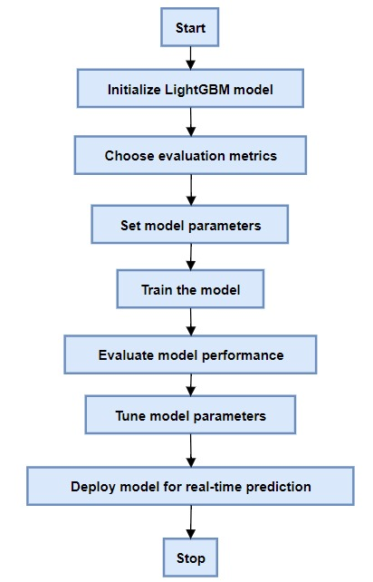
FUNCTIONAL DESCRIPTION OF MODULES
LightGBM
In LightGBM churn prediction, key steps involve initializing model parameters and choosing evaluation metrics. Parameters control tree complexity and convergence speed. The model is trained iteratively and evaluated on separate datasets. Once optimized, it's deployed for real-time churn prediction, aiding retention decisions. This process enhances understanding of customer behavior and facilitates proactive retention efforts.

Slide 11
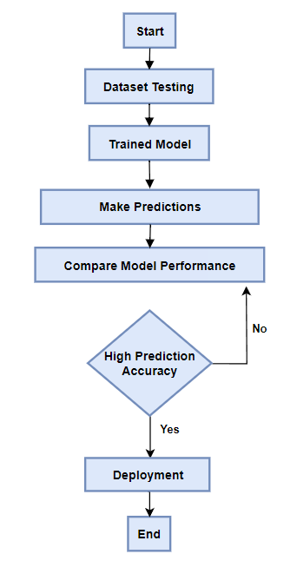
FUNCTIONAL DESCRIPTION OF MODULES
Model Evaluation and Deployment
The churn prediction process concludes with evaluating the model's performance using metrics like recall, accuracy, precision, F1 score aligning them with business objectives. Once the best-performing model is identified, it's deployed for real-time predictions, with continuous monitoring and periodic retraining ensuring sustained efficacy in addressing customer attrition and enhancing retention strategies

Slide 12
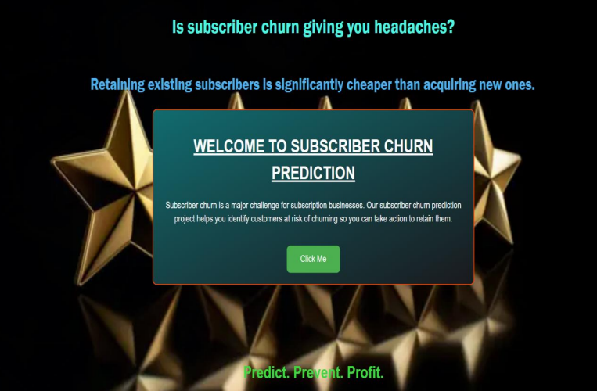
IMPLEMENTATION

Slide 13
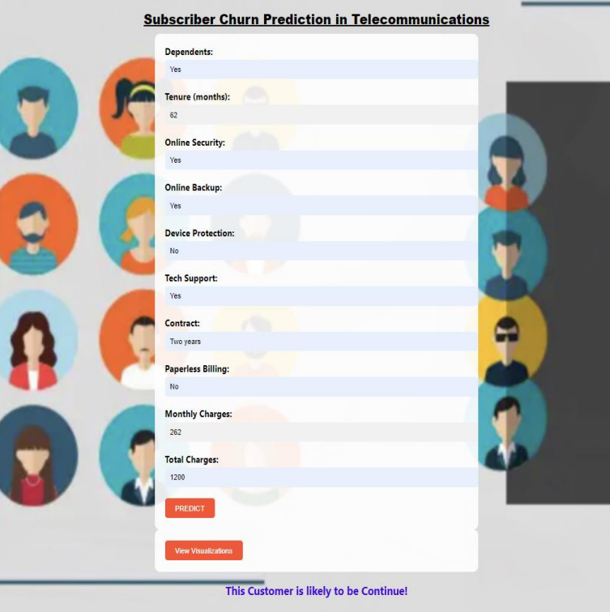

IMPLEMENTATION

Slide 14
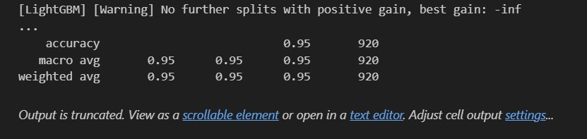
MODEL ACCURACY

Slide 15
PAPER PUBLICATION STATUS
PHASE - I:: Anandhi S, Ilakia S R, Shruthi K – Customer Churn Prediction using Deep Learning. International Conference on Intelligent Computing and Smart Communication Systems (ICICSCS’23)
https://drive.google.com/file/d/1dukhcLuY0KkxkBNk-hcn3jOUI0ev8XpN/view?usp=drivesdk
PHASE - II:: Anandhi S, Ilakia S R, Shruthi K - Telecom Subscriber Churn Prediction Using Deep Learning: Examining the Influence of Customer Characteristics and Service Offerings. Scopus-Journal. International Conference for Intelligent technologies (Submitted).

Slide 16
REFERENCES
[1] Agarwal, V., Taware, S., Yadav, S. A., Gangodkar, D., Rao, A. L. N., & Srivastav, V. K. (2022, October). Customer-Churn Prediction Using Machine Learning. In 2022 2nd International Conference on Technological Advancements in Computational Sciences (ICTACS) (pp. 893-899). IEEE.
[2] Agrawal, S., Das, A., Gaikwad, A., & Dhage, S. (2018, July). Customer churn prediction modelling based on behavioural patterns analysis using deep learning. In 2018 International conference on smart computing and electronic enterprise (ICSCEE) (pp. 1-6). IEEE.
[3] Ahmad, A. K., Jafar, A., & Aljoumaa, K. (2019). Customer churn prediction in telecom using machine learning in big data platform. Journal of Big Data, 6(1), 1-24.
[4] Ahmed, Ammar & Maheswari, D. (2017). A review and analysis of churn prediction methods for customer retention in telecom industries. 1-7.
[5] Amol Chole, Rushikesh Chavan, Shradha Mandan & Trupti Mate. (2023). Customers Churn Prediction using Machine Learning and Deep Learning. In 2023 Journal of Emerging Technologies and Innovative Research, ISSN-2349-5162.

Slide 17
REFERENCES
[6] Anvita Gupta, Komanduri Srikar, Sreenitya Mandav. (2022) ‘Customer Churn Prediction in Banking Sector - A Hybrid Approach’, International Journal for Research in Applied Science & Engineering Technology (IJRASET), pp. 1-6.
[7] Bhatnagar, A., & Srivastava, S. (2019, December). A robust model for churn prediction using supervised machine learning. In 2019 IEEE 9th international conference on advanced computing (IACC) (pp. 45-49). IEEE.
[8] Bhuse, P., Gandhi, A., Meswani, P., Muni, R., & Katre, N. (2020, December). Machine learning based telecom-customer churn prediction. In 2020 3rd International Conference on Intelligent Sustainable Systems (ICISS) (pp. 1297-1301). IEEE.
[9] Bin, Luo & Peiji, Shao & Juan, Liu. (2007). Customer Churn Prediction Based on the Decision Tree in Personal Handyphone System Service. Proceedings - ICSSSM'07: 2007 International Conference on Service Systems and Service Management. 1 - 5.
[10] Çelik, O., & Osmanoglu, U. O. (2019). Comparing to techniques used in customer churn analysis. Journal of Multidisciplinary Developments, 4(1), 30-38.

Slide 18
REFERENCES
[11] Fujo, S. W., Subramanian, S., & Khder, M. A. (2022). Customer churn prediction in telecommunication industry using deep learning. Information Sciences Letters, 11(1), 24.
[12] Gaur, A., & Dubey, R. (2018, December). Predicting customer churn prediction in telecom sector using various machine learning techniques. In 2018 International Conference on Advanced Computation and Telecommunication (ICACAT) (pp. 1-5). Ieee.
[13] Hu, J., Zhuang, Y., Yang, J., Lei, L., Huang, M., Zhu, R., & Dong, S. (2018, December). pRNN: A recurrent neural network based approach for customer churn prediction in telecommunication sector. In 2018 IEEE International Conference on Big Data (Big Data) (pp. 4081-4085). IEEE.
[14] Ismail, M. R., Awang, M. K., Rahman, M. N. A., & Makhtar, M. (2015). A multi-layer perceptron approach for customer churn prediction. International Journal of Multimedia and Ubiquitous Engineering, 10(7), 213-222.
[15] Karvana, K. G. M., Yazid, S., Syalim, A., & Mursanto, P. (2019, October). Customer churn analysis and prediction using data mining models in banking industry. In 2019 international workshop on big data and information security (IWBIS) (pp. 33-38). IEEE.

Slide 19
REFERENCES
[16] Kumar, P., and Kumar, S.V. (2023). DDoS Attack Prediction System Using Machine Learning Algorithms. In: Tuba, M., Akashe, S., Joshi, A. (eds) ICT Systems and Sustainability. ICT4SD 2023. Lecture Notes in Networks and Systems, vol 765. Springer, Singapore.
[17] Kumar, P., Vinodh Kumar, S., and Priya, L. (2023). An Approach for Energy-Efficient Resource Allocation Through Early Planning of Virtual Machines to Servers in Cloud Server Farms. In: Doriya, R., Soni, B., Shukla, A., Gao, XZ. (eds) Machine Learning, Image Processing, Network Security and Data Sciences. Lecture Notes in Electrical Engineering, vol 946. Springer, Singapore.
[18] Maw, M., Haw, S. C., & Ho, C. K. (2019, November). Customer Churn Prediction in Telecommunication: An Analysis on Issues, Techniques and Future Trends. In 2019 IEEE Conference on Sustainable Utilization and Development in Engineering and Technologies (CSUDET) (pp. 148-153). IEEE.
[19] Sudharsan, R., & Ganesh, E. N. (2022). A Swish RNN based customer churn prediction for the telecom industry with a novel feature selection strategy. Connection Science, 34(1), 1855-1876.
[20] Zhang, T., Moro, S., & Ramos, R. F. (2022). A data-driven approach to improve customer churn prediction based on telecom customer segmentation. Future Internet, 14(3), 94.

Slide 20
THANK YOU

